Slide 1


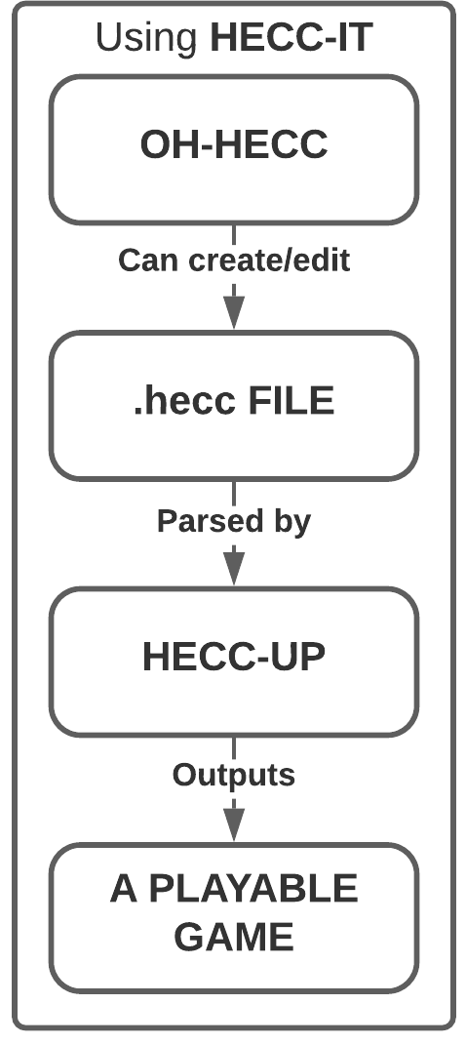
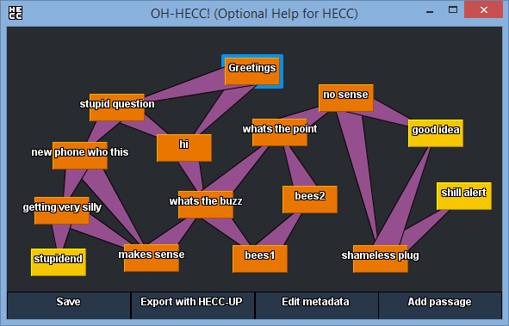
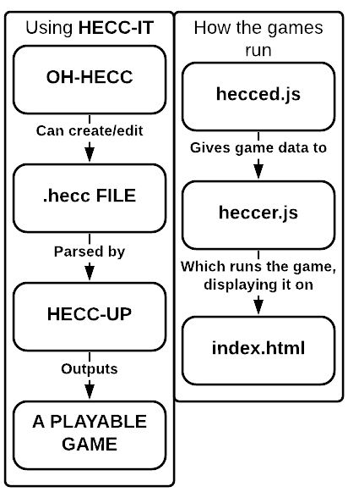
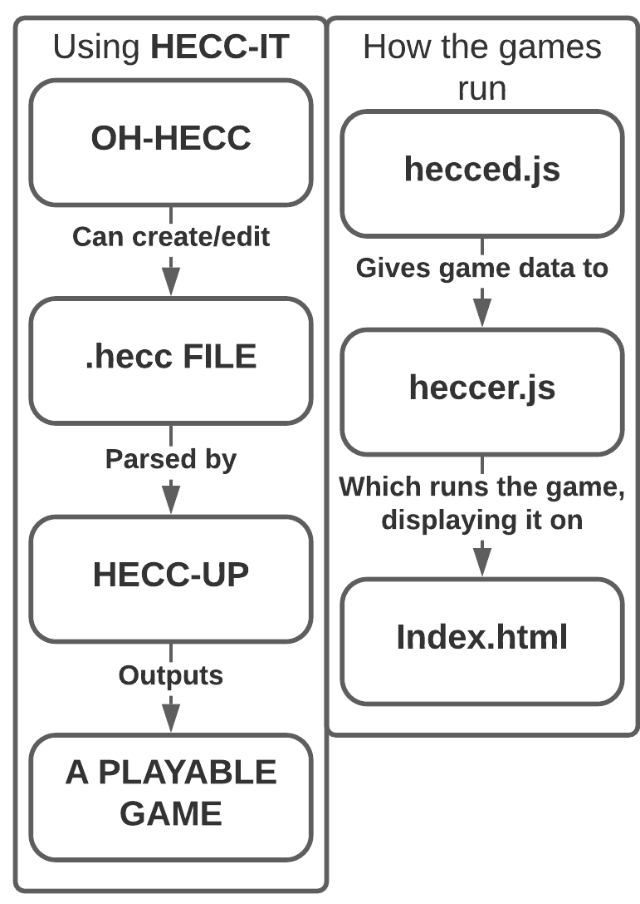
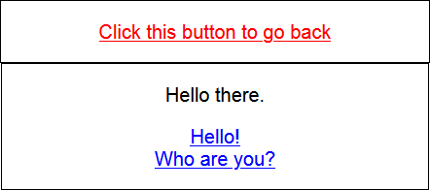
Hypertext Game Project
HECC-IT!
Rachel Lowe (Supervisor: Dr Richard Bartle)
WHAT IS HECC-IT?
Hypertext Editing and Creation Code Integrated Toolkit is the hypertext game authoring tool made for indecisive people.
Most existing systems require users to use a GUI or to write raw code and hope it compiles. But no tools offer users the choice between the two (or, if they do, with some caveats).
But not HECC-IT.
You’re a power user who doesn’t want to faff around with a GUI? You can just write .hecc code! You’re a casual user who wants a GUI? Just open OH-HECC!
And then, once that’s done, just put it through HECC-UP and you have your playable HECC-Infused Nice Game!
HECC-IT is a standalone desktop application, so users only need to download it and run it.
Games made with HECC-IT are in a client-side HTML/JavaScript format, so anyone with a web browser can download and play them.
HOW DOES IT WORK?
HECC-IT is a toolkit, within a single executable.
Users open the executable, pick an existing .hecc file (or make one), and is then given the choice to export it now or keep editing it (and export later).
Once exported, users can just open the index.html page, and they can play their game!
Above: A screenshot of OH-HECC (Optional Help for HECC; the editing GUI) showing the network of passages for an example game.
Below: A screenshot of the start passage for that game after exporting it via HECC-UP (HECC Ultra Parser)

